Slide 1
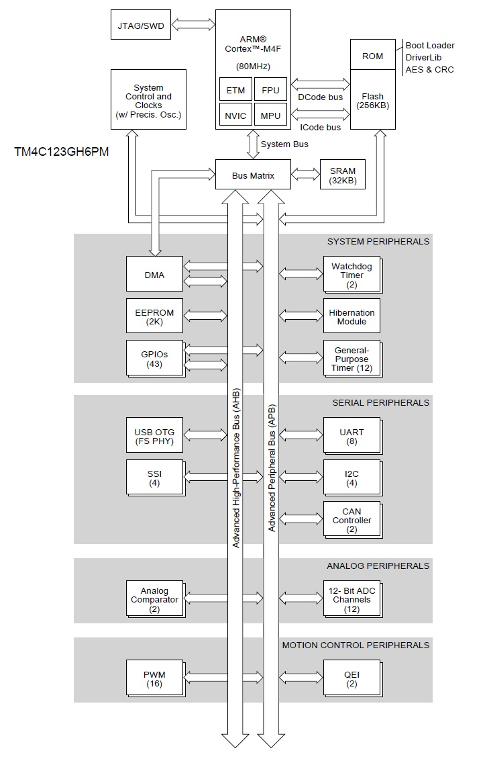
Texas Instruments Tiva TM4C123GH6PM Microcontroller
(TI Tiva TM4C123GH6PM Microcontroller High-Level Block Diagram)
Produced by Sh. Yaghni

Slide 2
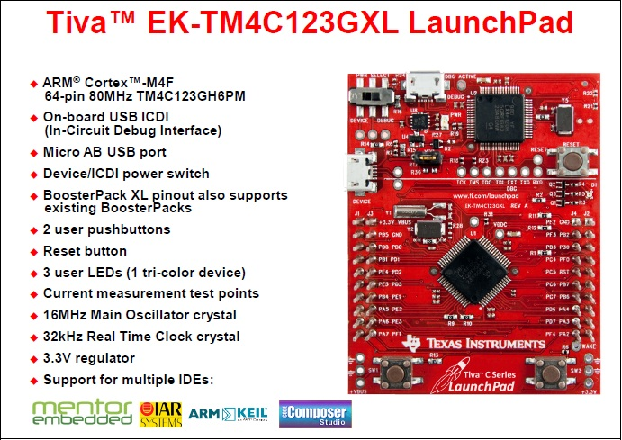
Texas Instruments Tiva TM4C123GH6PM Microcontroller
(TI Tiva LaunchPad Trainer board)
Produced by Sh. Yaghni

Slide 3
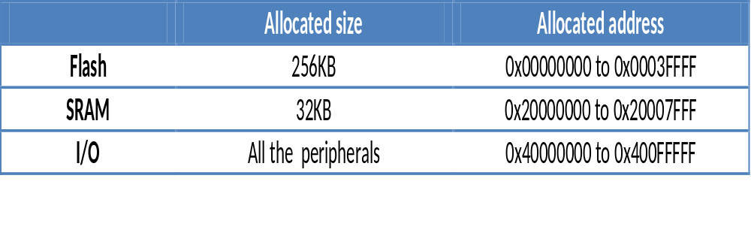
Texas Instruments Tiva TM4C123GH6PM Microcontroller
(Memory Map in TM4C123GH6PM)
Produced by Sh. Yaghni

Slide 4
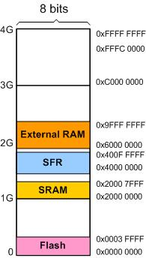
Texas Instruments Tiva TM4C123GH6PM Microcontroller
(Memory Map )
Produced by Sh. Yaghni

Slide 5
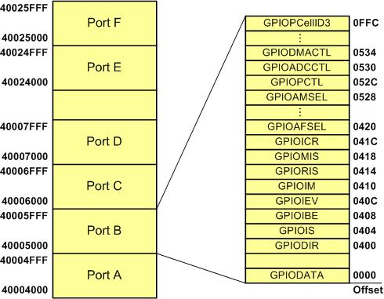
GPIO
(GPIO Memory Map)
Produced by Sh. Yaghni

Slide 6
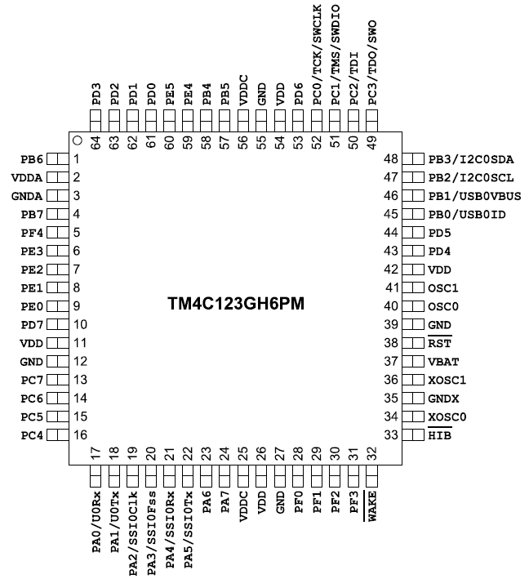
I/O Pins in TI Tiva LaunchPad
(TM4C134GH6PM Pin-out)
Produced by Sh. Yaghni

